Slide 1
Computer Vision
Filtering

Slide 2
Three views of filtering
Image filters in spatial domain
Filter is a mathematical operation of a grid of numbers
Smoothing, sharpening, measuring texture
Image filters in the frequency domain
Filtering is a way to modify the frequencies of images
Denoising, sampling, image compression
Templates and Image Pyramids
Filtering is a way to match a template to the image
Detection, coarse-to-fine registration

Slide 3
Image filtering
Image filtering: compute function of local neighborhood at each position
Really important!
Enhance images
Denoise, resize, increase contrast, etc.
Extract information from images
Texture, edges, distinctive points, etc.
Detect patterns
Template matching

Slide 4
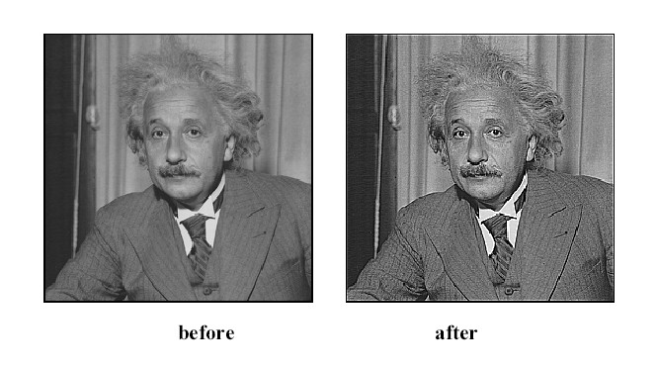

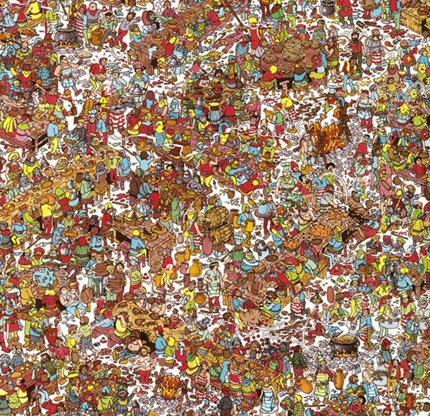
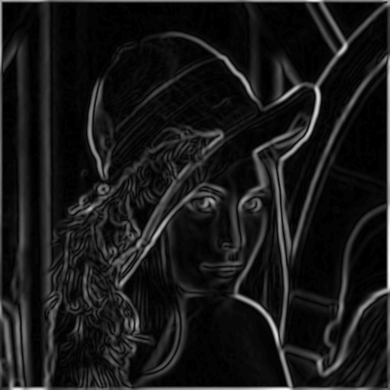
Today: Image Filters
Smooth/Sharpen Images... Find edges... Find waldo…

Slide 5
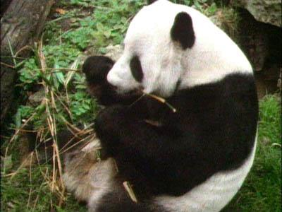
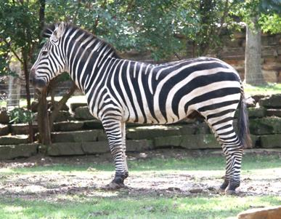
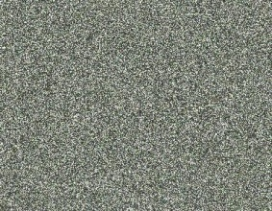
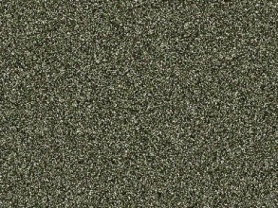
Image neighborhoods
Q: What happens if we reshuffle all pixels within the images?
A: Its histogram won’t change. Point-wise processing unaffected.
Need to measure properties relative to small neighborhoods of pixels

Slide 6
Images as functions
Source: S. Seitz

Slide 7
Images as functions
We can think of an image as a function, f, from R² to R:
f( x, y ) gives the intensity at position ( x, y )
Realistically, we expect the image only to be defined over a rectangle, with a finite range:
f: [a,b] x [c,d] → [0, 1.0]
A color image is just three functions pasted together. We can write this as a “vector-valued” function:
Source: S. Seitz

Slide 8

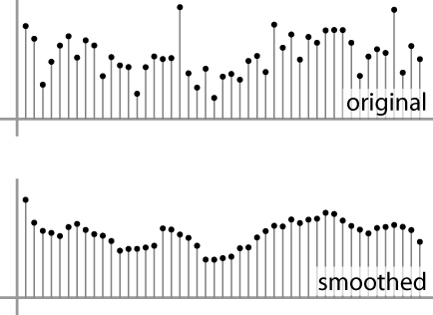
Digital images
In computer vision we operate on digital (discrete) images:
Sample the 2D space on a regular grid
Quantize each sample (round to nearest integer)
Image thus represented as a matrix of integer values.
2D
1D
Adapted from S. Seitz

Slide 9
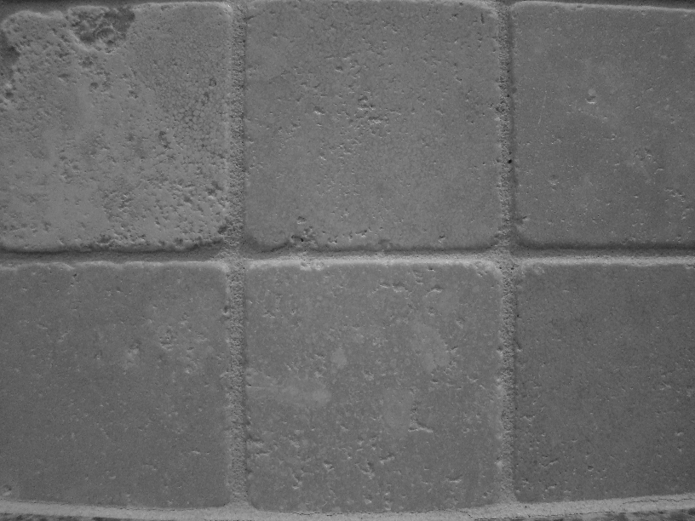
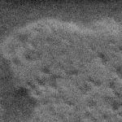
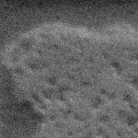

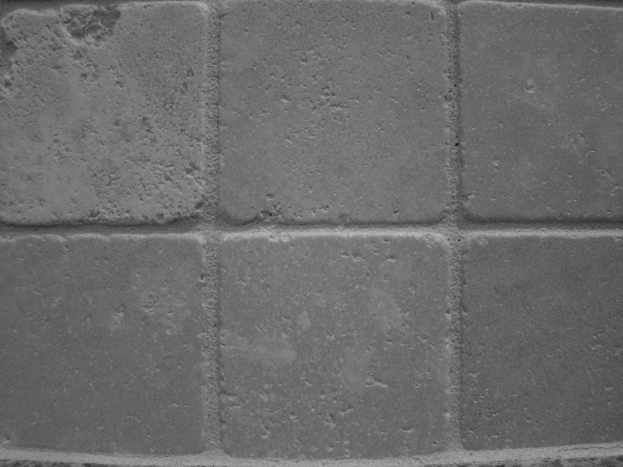
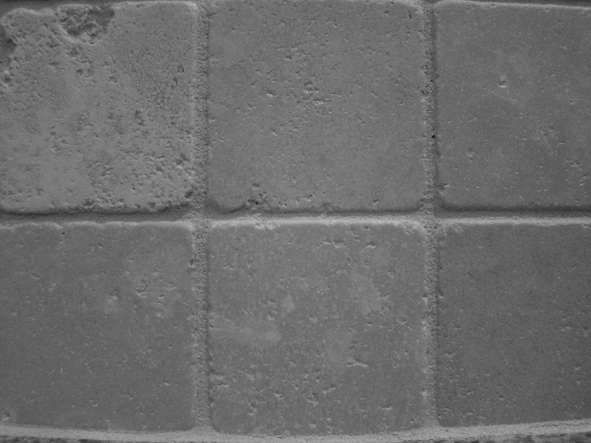


Motivation: noise reduction
We can measure noise in multiple images of the same static scene.
How could we reduce the noise, i.e., give an estimate of the true intensities?

Slide 10
Common types of noise
Salt and pepper noise: random occurrences of black and white pixels
Impulse noise: random occurrences of white pixels
Gaussian noise: variations in intensity drawn from a Gaussian normal distribution
Source: S. Seitz

Slide 11
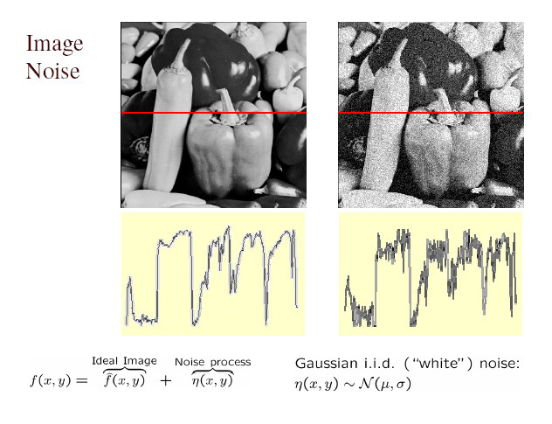
Gaussian noise
Fig: M. Hebert

Slide 12
Motivation: noise reduction
How could we reduce the noise, i.e., give an estimate of the true intensities?
What if there’s only one image?

Slide 13
First attempt at a solution
Let’s replace each pixel with an average of all the values in its neighborhood
Assumptions:
Expect pixels to be like their neighbors
Expect noise processes to be independent from pixel to pixel

Slide 14
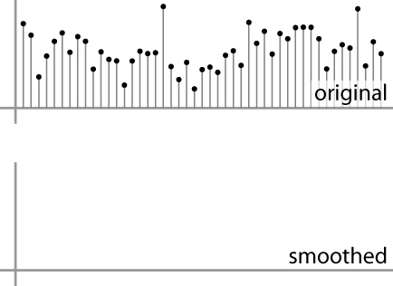
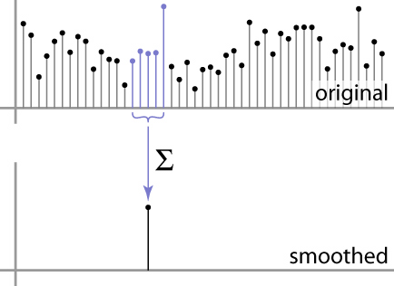
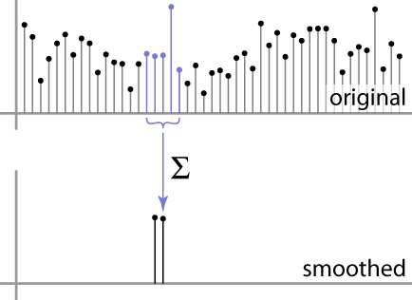
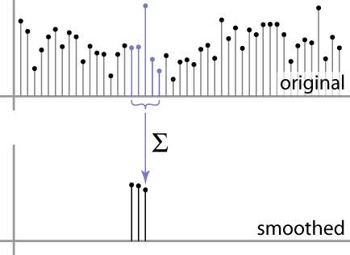
First attempt at a solution
Let’s replace each pixel with an average of all the values in its neighborhood
Moving average in 1D:
Source: S. Marschner

Slide 15
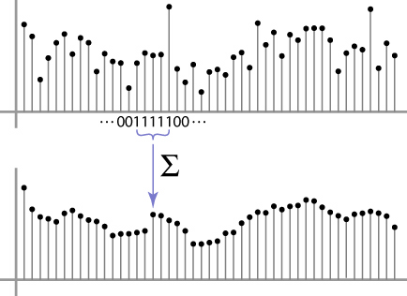
Weighted Moving Average
Can add weights to our moving average
Weights [1, 1, 1, 1, 1] / 5
Source: S. Marschner

Slide 16

Weighted Moving Average
Non-uniform weights [1, 4, 6, 4, 1] / 16
Source: S. Marschner

Slide 17
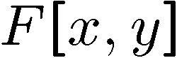
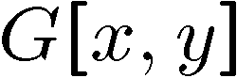
Moving Average In 2D
0 | 0 | 0 | 0 | 0 | 0 | 0 | 0 | 0 | 0
0 | 0 | 0 | 0 | 0 | 0 | 0 | 0 | 0 | 0
0 | 0 | 0 | 90 | 90 | 90 | 90 | 90 | 0 | 0
0 | 0 | 0 | 90 | 90 | 90 | 90 | 90 | 0 | 0
0 | 0 | 0 | 90 | 90 | 90 | 90 | 90 | 0 | 0
0 | 0 | 0 | 90 | 0 | 90 | 90 | 90 | 0 | 0
0 | 0 | 0 | 90 | 90 | 90 | 90 | 90 | 0 | 0
0 | 0 | 0 | 0 | 0 | 0 | 0 | 0 | 0 | 0
0 | 0 | 90 | 0 | 0 | 0 | 0 | 0 | 0 | 0
0 | 0 | 0 | 0 | 0 | 0 | 0 | 0 | 0 | 0
 | 0
0 | 0 | 0 | 0 | 0 | 0 | 0 | 0 | 0 | 0
0 | 0 | 0 | 0 | 0 | 0 | 0 | 0 | 0 | 0
0 | 0 | 0 | 90 | 90 | 90 | 90 | 90 | 0 | 0
0 | 0 | 0 | 90 | 90 | 90 | 90 | 90 | 0 | 0
0 | 0 | 0 | 90 | 90 | 90 | 90 | 90 | 0 | 0
0 | 0 | 0 | 90 | 0 | 90 | 90 | 90 | 0 | 0
0 | 0 | 0 | 90 | 90 | 90 | 90 | 90 | 0 | 0
0 | 0 | 0 | 0 | 0 | 0 | 0 | 0 | 0 | 0
0 | 0 | 90 | 0 | 0 | 0 | 0 | 0 | 0 | 0
0 | 0 | 0 | 0 | 0 | 0 | 0 | 0 | 0 | 0
Source: S. Seitz
Notes:
ones, divide by 9

Slide 18
Moving Average In 2D
0 | 0 | 0 | 0 | 0 | 0 | 0 | 0 | 0 | 0
0 | 0 | 0 | 0 | 0 | 0 | 0 | 0 | 0 | 0
0 | 0 | 0 | 90 | 90 | 90 | 90 | 90 | 0 | 0
0 | 0 | 0 | 90 | 90 | 90 | 90 | 90 | 0 | 0
0 | 0 | 0 | 90 | 90 | 90 | 90 | 90 | 0 | 0
0 | 0 | 0 | 90 | 0 | 90 | 90 | 90 | 0 | 0
0 | 0 | 0 | 90 | 90 | 90 | 90 | 90 | 0 | 0
0 | 0 | 0 | 0 | 0 | 0 | 0 | 0 | 0 | 0
0 | 0 | 90 | 0 | 0 | 0 | 0 | 0 | 0 | 0
0 | 0 | 0 | 0 | 0 | 0 | 0 | 0 | 0 | 0
 | 0 | 10
0 | 0 | 0 | 0 | 0 | 0 | 0 | 0 | 0 | 0
0 | 0 | 0 | 0 | 0 | 0 | 0 | 0 | 0 | 0
0 | 0 | 0 | 90 | 90 | 90 | 90 | 90 | 0 | 0
0 | 0 | 0 | 90 | 90 | 90 | 90 | 90 | 0 | 0
0 | 0 | 0 | 90 | 90 | 90 | 90 | 90 | 0 | 0
0 | 0 | 0 | 90 | 0 | 90 | 90 | 90 | 0 | 0
0 | 0 | 0 | 90 | 90 | 90 | 90 | 90 | 0 | 0
0 | 0 | 0 | 0 | 0 | 0 | 0 | 0 | 0 | 0
0 | 0 | 90 | 0 | 0 | 0 | 0 | 0 | 0 | 0
0 | 0 | 0 | 0 | 0 | 0 | 0 | 0 | 0 | 0
Source: S. Seitz
Notes:
ones, divide by 9

Slide 19
Moving Average In 2D
0 | 0 | 0 | 0 | 0 | 0 | 0 | 0 | 0 | 0
0 | 0 | 0 | 0 | 0 | 0 | 0 | 0 | 0 | 0
0 | 0 | 0 | 90 | 90 | 90 | 90 | 90 | 0 | 0
0 | 0 | 0 | 90 | 90 | 90 | 90 | 90 | 0 | 0
0 | 0 | 0 | 90 | 90 | 90 | 90 | 90 | 0 | 0
0 | 0 | 0 | 90 | 0 | 90 | 90 | 90 | 0 | 0
0 | 0 | 0 | 90 | 90 | 90 | 90 | 90 | 0 | 0
0 | 0 | 0 | 0 | 0 | 0 | 0 | 0 | 0 | 0
0 | 0 | 90 | 0 | 0 | 0 | 0 | 0 | 0 | 0
0 | 0 | 0 | 0 | 0 | 0 | 0 | 0 | 0 | 0
 | 0 | 10 | 20
0 | 0 | 0 | 0 | 0 | 0 | 0 | 0 | 0 | 0
0 | 0 | 0 | 0 | 0 | 0 | 0 | 0 | 0 | 0
0 | 0 | 0 | 90 | 90 | 90 | 90 | 90 | 0 | 0
0 | 0 | 0 | 90 | 90 | 90 | 90 | 90 | 0 | 0
0 | 0 | 0 | 90 | 90 | 90 | 90 | 90 | 0 | 0
0 | 0 | 0 | 90 | 0 | 90 | 90 | 90 | 0 | 0
0 | 0 | 0 | 90 | 90 | 90 | 90 | 90 | 0 | 0
0 | 0 | 0 | 0 | 0 | 0 | 0 | 0 | 0 | 0
0 | 0 | 90 | 0 | 0 | 0 | 0 | 0 | 0 | 0
0 | 0 | 0 | 0 | 0 | 0 | 0 | 0 | 0 | 0
Source: S. Seitz
Notes:
ones, divide by 9

Slide 20
Moving Average In 2D
0 | 0 | 0 | 0 | 0 | 0 | 0 | 0 | 0 | 0
0 | 0 | 0 | 0 | 0 | 0 | 0 | 0 | 0 | 0
0 | 0 | 0 | 90 | 90 | 90 | 90 | 90 | 0 | 0
0 | 0 | 0 | 90 | 90 | 90 | 90 | 90 | 0 | 0
0 | 0 | 0 | 90 | 90 | 90 | 90 | 90 | 0 | 0
0 | 0 | 0 | 90 | 0 | 90 | 90 | 90 | 0 | 0
0 | 0 | 0 | 90 | 90 | 90 | 90 | 90 | 0 | 0
0 | 0 | 0 | 0 | 0 | 0 | 0 | 0 | 0 | 0
0 | 0 | 90 | 0 | 0 | 0 | 0 | 0 | 0 | 0
0 | 0 | 0 | 0 | 0 | 0 | 0 | 0 | 0 | 0
 | 0 | 10 | 20 | 30
0 | 0 | 0 | 0 | 0 | 0 | 0 | 0 | 0 | 0
0 | 0 | 0 | 0 | 0 | 0 | 0 | 0 | 0 | 0
0 | 0 | 0 | 90 | 90 | 90 | 90 | 90 | 0 | 0
0 | 0 | 0 | 90 | 90 | 90 | 90 | 90 | 0 | 0
0 | 0 | 0 | 90 | 90 | 90 | 90 | 90 | 0 | 0
0 | 0 | 0 | 90 | 0 | 90 | 90 | 90 | 0 | 0
0 | 0 | 0 | 90 | 90 | 90 | 90 | 90 | 0 | 0
0 | 0 | 0 | 0 | 0 | 0 | 0 | 0 | 0 | 0
0 | 0 | 90 | 0 | 0 | 0 | 0 | 0 | 0 | 0
0 | 0 | 0 | 0 | 0 | 0 | 0 | 0 | 0 | 0
Source: S. Seitz
Notes:
ones, divide by 9

Slide 21
Moving Average In 2D
0 | 0 | 0 | 0 | 0 | 0 | 0 | 0 | 0 | 0
0 | 0 | 0 | 0 | 0 | 0 | 0 | 0 | 0 | 0
0 | 0 | 0 | 90 | 90 | 90 | 90 | 90 | 0 | 0
0 | 0 | 0 | 90 | 90 | 90 | 90 | 90 | 0 | 0
0 | 0 | 0 | 90 | 90 | 90 | 90 | 90 | 0 | 0
0 | 0 | 0 | 90 | 0 | 90 | 90 | 90 | 0 | 0
0 | 0 | 0 | 90 | 90 | 90 | 90 | 90 | 0 | 0
0 | 0 | 0 | 0 | 0 | 0 | 0 | 0 | 0 | 0
0 | 0 | 90 | 0 | 0 | 0 | 0 | 0 | 0 | 0
0 | 0 | 0 | 0 | 0 | 0 | 0 | 0 | 0 | 0
 | 0 | 10 | 20 | 30 | 30
Source: S. Seitz
Notes:
ones, divide by 9

Slide 22
Moving Average In 2D
0 | 0 | 0 | 0 | 0 | 0 | 0 | 0 | 0 | 0
0 | 0 | 0 | 0 | 0 | 0 | 0 | 0 | 0 | 0
0 | 0 | 0 | 90 | 90 | 90 | 90 | 90 | 0 | 0
0 | 0 | 0 | 90 | 90 | 90 | 90 | 90 | 0 | 0
0 | 0 | 0 | 90 | 90 | 90 | 90 | 90 | 0 | 0
0 | 0 | 0 | 90 | 0 | 90 | 90 | 90 | 0 | 0
0 | 0 | 0 | 90 | 90 | 90 | 90 | 90 | 0 | 0
0 | 0 | 0 | 0 | 0 | 0 | 0 | 0 | 0 | 0
0 | 0 | 90 | 0 | 0 | 0 | 0 | 0 | 0 | 0
0 | 0 | 0 | 0 | 0 | 0 | 0 | 0 | 0 | 0
 | 0 | 10 | 20 | 30 | 30 | 30 | 20 | 10
 | 0 | 20 | 40 | 60 | 60 | 60 | 40 | 20
 | 0 | 30 | 60 | 90 | 90 | 90 | 60 | 30
 | 0 | 30 | 50 | 80 | 80 | 90 | 60 | 30
 | 0 | 30 | 50 | 80 | 80 | 90 | 60 | 30
 | 0 | 20 | 30 | 50 | 50 | 60 | 40 | 20
 | 10 | 20 | 30 | 30 | 30 | 30 | 20 | 10
 | 10 | 10 | 10 | 0 | 0 | 0 | 0 | 0
Source: S. Seitz
Notes:
ones, divide by 9

Slide 23
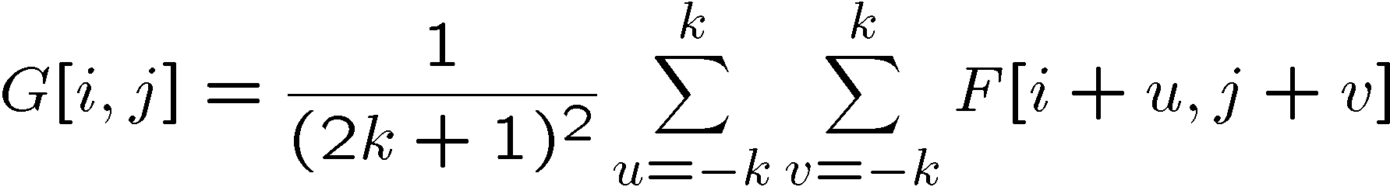
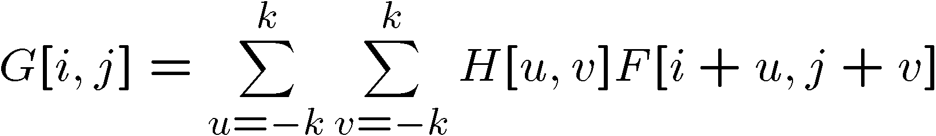
Correlation filtering
Say the averaging window size is 2k+1 x 2k+1:
Attribute uniform weight to each pixel
Loop over all pixels in neighborhood around image pixel F[i,j]
Now generalize to allow different weights depending on neighboring pixel’s relative position:
Non-uniform weights

Slide 24
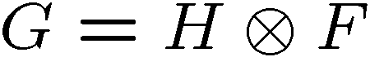
Correlation filtering
This is called cross-correlation, denoted
Filtering an image: replace each pixel with a linear combination of its neighbors.
The filter “kernel” or “mask” H[u,v] is the prescription for the weights in the linear combination.

Slide 25
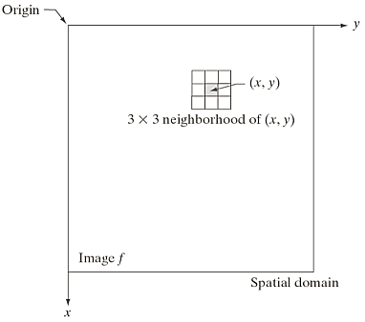
spatial filtering
Filter term in “Digital image processing” is referred to the subimage
Others terms - mask, kernel, template, or window
The value in a filter subimage are referred as coefficients, rather than pixels.
The word “filtering” has been borrowed from the frequency domain.
Spatial filtering term is the filtering operations that are performed directly on the pixels of an image

Slide 26
Mechanics of spatial filtering
Need to define:
(1) a neighborhood (or mask) - Typically, rectangular and its size is much smaller than that of f(x,y)
e.g. - 3x3 or 5x5
(2) an operation
e.g. - weighted sum of input pixels

Slide 27
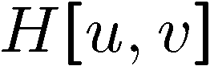

Averaging filter
What values belong in the kernel H for the moving average example?
0 | 0 | 0 | 0 | 0 | 0 | 0 | 0 | 0 | 0
0 | 0 | 0 | 0 | 0 | 0 | 0 | 0 | 0 | 0
0 | 0 | 0 | 90 | 90 | 90 | 90 | 90 | 0 | 0
0 | 0 | 0 | 90 | 90 | 90 | 90 | 90 | 0 | 0
0 | 0 | 0 | 90 | 90 | 90 | 90 | 90 | 0 | 0
0 | 0 | 0 | 90 | 0 | 90 | 90 | 90 | 0 | 0
0 | 0 | 0 | 90 | 90 | 90 | 90 | 90 | 0 | 0
0 | 0 | 0 | 0 | 0 | 0 | 0 | 0 | 0 | 0
0 | 0 | 90 | 0 | 0 | 0 | 0 | 0 | 0 | 0
0 | 0 | 0 | 0 | 0 | 0 | 0 | 0 | 0 | 0
 | 0 | 10 | 20 | 30 | 30
1
1
1
1
?
1
1
1
1
1
“box filter”

Slide 28
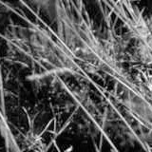
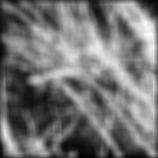
Smoothing by averaging
depicts box filter:
white = high value, black = low value
original
filtered

Slide 29
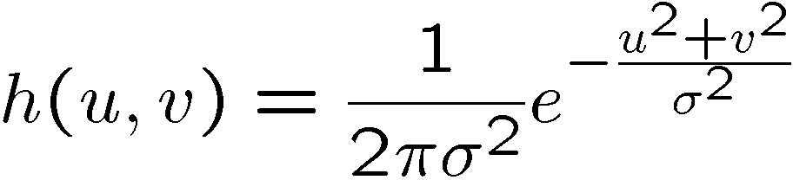
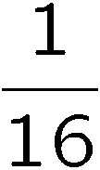
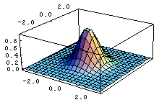
Gaussian filter
What if we want nearest neighboring pixels to have the most influence on the output?
This kernel is an approximation of a Gaussian function:
0 | 0 | 0 | 0 | 0 | 0 | 0 | 0 | 0 | 0
0 | 0 | 0 | 0 | 0 | 0 | 0 | 0 | 0 | 0
0 | 0 | 0 | 90 | 90 | 90 | 90 | 90 | 0 | 0
0 | 0 | 0 | 90 | 90 | 90 | 90 | 90 | 0 | 0
0 | 0 | 0 | 90 | 90 | 90 | 90 | 90 | 0 | 0
0 | 0 | 0 | 90 | 0 | 90 | 90 | 90 | 0 | 0
0 | 0 | 0 | 90 | 90 | 90 | 90 | 90 | 0 | 0
0 | 0 | 0 | 0 | 0 | 0 | 0 | 0 | 0 | 0
0 | 0 | 90 | 0 | 0 | 0 | 0 | 0 | 0 | 0
0 | 0 | 0 | 0 | 0 | 0 | 0 | 0 | 0 | 0
1 | 2 | 1
2 | 4 | 2
1 | 2 | 1
Source: S. Seitz

Slide 30
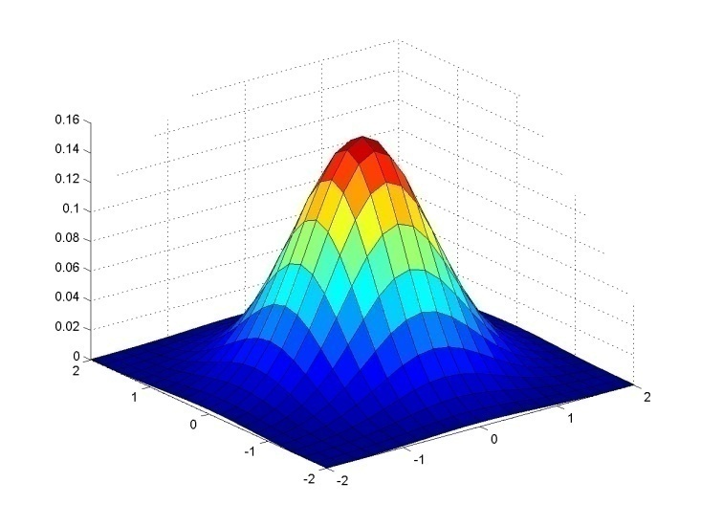
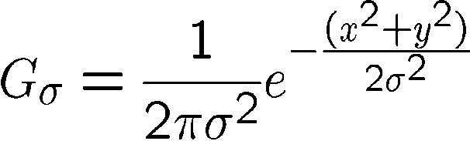
Gaussian filter
Weight contributions of neighboring pixels by nearness
0.003 0.013 0.022 0.013 0.003
0.013 0.059 0.097 0.059 0.013
0.022 0.097 0.159 0.097 0.022
0.013 0.059 0.097 0.059 0.013
0.003 0.013 0.022 0.013 0.003
5 x 5, σ = 1
Slide credit: Christopher Rasmussen
Notes:
e^0 = 1, e^-1 = .37, e^-2 = .14, etc.

Slide 31

Smoothing with a Gaussian

Slide 32
Smoothing with a Box filter

Slide 33
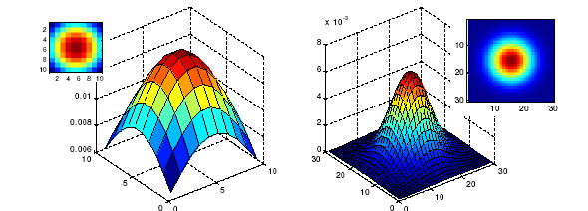
Gaussian filters
What parameters matter here?
Size of kernel or mask
Note, Gaussian function has infinite support, but discrete filters use finite kernels
σ = 5 with 10 x 10 kernel
σ = 5 with 30 x 30 kernel

Slide 34
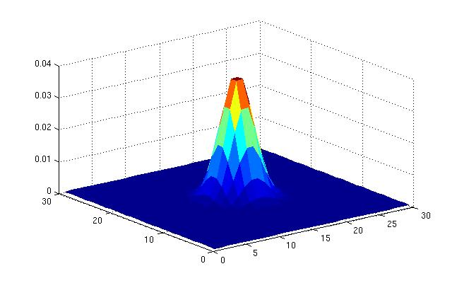
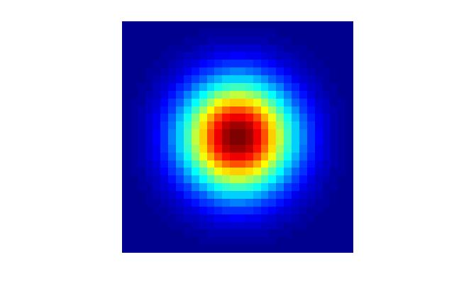
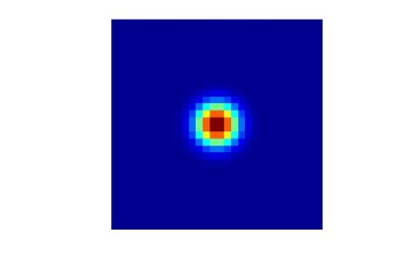
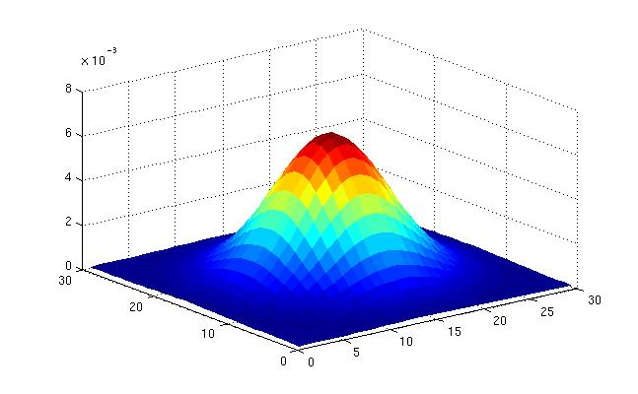
Gaussian filters
What parameters matter here?
Variance of Gaussian: determines extent of smoothing
σ = 2 with 30 x 30 kernel
σ = 5 with 30 x 30 kernel

Slide 35
Gaussian filters
Remove “high-frequency” components from the image (low-pass filter)
Images become more smooth
Convolution with self is another Gaussian
So can smooth with small-width kernel, repeat, and get same result as larger-width kernel would have
Convolving two times with Gaussian kernel of width σ is same as convolving once with kernel of width σ√2
Separable kernel
Factors into product of two 1D Gaussians
Source: K. Grauman
Notes:
Linear vs. quadratic in mask size

Slide 36
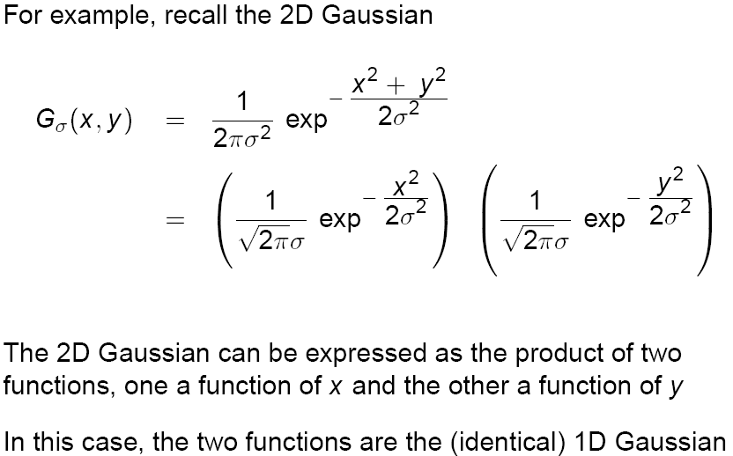
Separability of the Gaussian filter
Source: D. Lowe

Slide 37
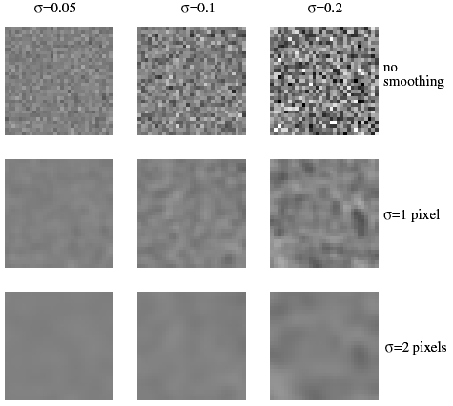
More noise →
Wider smoothing kernel →

Slide 38
Boundary issues
What is the size of the output?
g
g
g
g
f
f
f
g
g
g
g
g
g
g
g
Source: S. Lazebnik

Slide 39
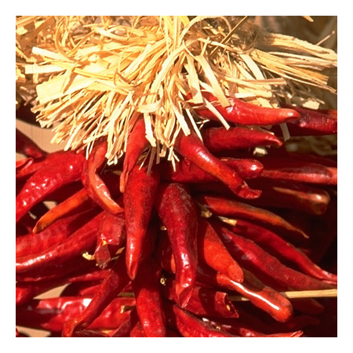












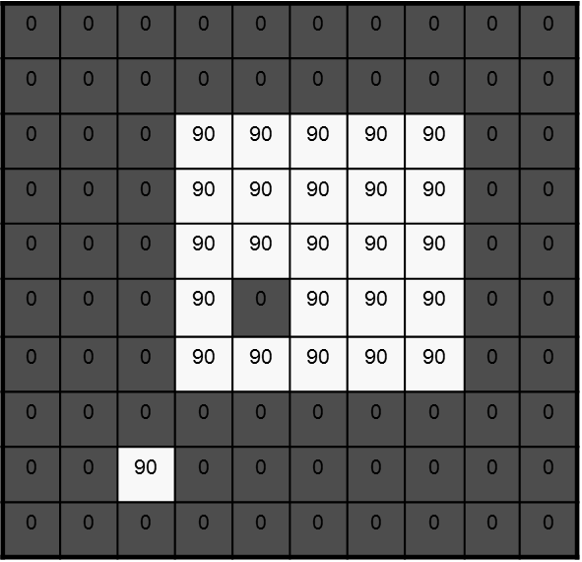
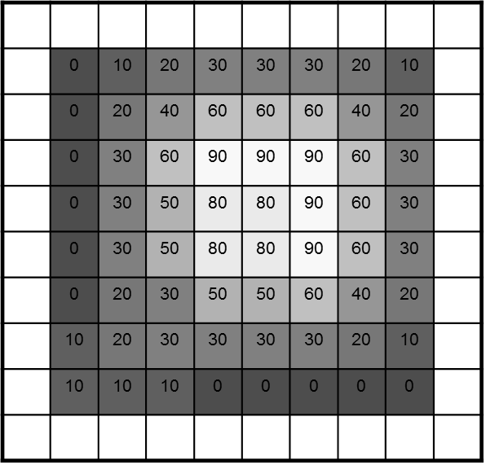
Boundary issues
What about near the edge?
the filter window falls off the edge of the image
need to extrapolate
methods:
clip filter (black)
wrap around
copy edge
reflect across edge
Wrap
Copy
Reflect
Clip
Source: S. Marschner

Slide 40
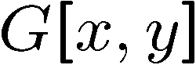
Filtering an impulse signal
What is the result of filtering the impulse signal (image) F with the arbitrary kernel H?
0 | 0 | 0 | 0 | 0 | 0 | 0
0 | 0 | 0 | 0 | 0 | 0 | 0
0 | 0 | 0 | 0 | 0 | 0 | 0
0 | 0 | 0 | 1 | 0 | 0 | 0
0 | 0 | 0 | 0 | 0 | 0 | 0
0 | 0 | 0 | 0 | 0 | 0 | 0
0 | 0 | 0 | 0 | 0 | 0 | 0
a | b | c
d | e | f
g | h | i
?

Slide 41
Filtering an impulse signal
What is the result of filtering the impulse signal (image) F with the arbitrary kernel H?
0 | 0 | 0 | 0 | 0 | 0 | 0
0 | 0 | 0 | 0 | 0 | 0 | 0
0 | 0 | 0 | 0 | 0 | 0 | 0
0 | 0 | 0 | 1 | 0 | 0 | 0
0 | 0 | 0 | 0 | 0 | 0 | 0
0 | 0 | 0 | 0 | 0 | 0 | 0
0 | 0 | 0 | 0 | 0 | 0 | 0
0 | 0 | 0 | 0 | 0 | 0 | 0
0 | 0 | 0 | 0 | 0 | 0 | 0
0 | 0 | 0 | 0 | 0 | 0 | 0
0 | 0 | 0 | 1 | 0 | 0 | 0
0 | 0 | 0 | 0 | 0 | 0 | 0
0 | 0 | 0 | 0 | 0 | 0 | 0
0 | 0 | 0 | 0 | 0 | 0 | 0
a | b | c
d | e | f
g | h | i
a | b | c
d | e | f
g | h | i

Slide 42
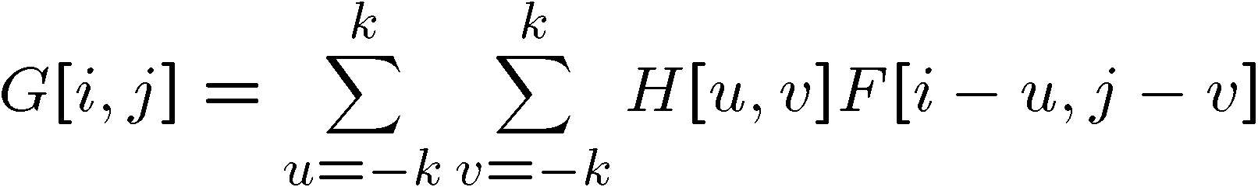


Convolution
Convolution:
Flip the filter in both dimensions (bottom to top, right to left)
Then apply cross-correlation
F
H
Notation for convolution operator

Slide 43
Convolution vs. correlation
Convolution
Cross-correlation
For a Gaussian or box filter, how will the outputs differ?
If the input is an impulse signal, how will the outputs differ?

Slide 44
Convolution
Convolution:
Flip the filter in both dimensions (bottom to top, right to left)
Then apply cross-correlation
F
H
Notation for convolution operator

Slide 45
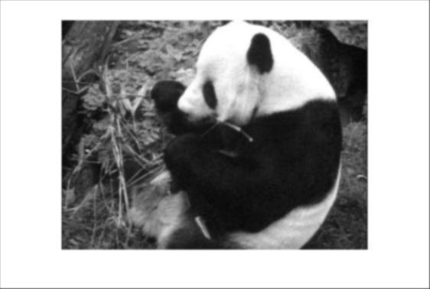
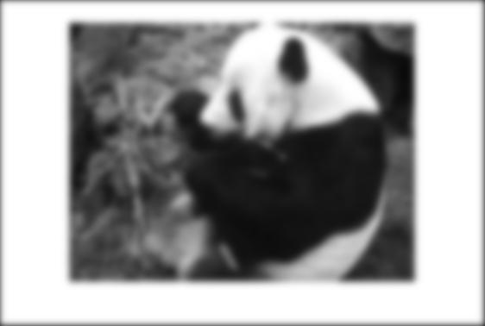
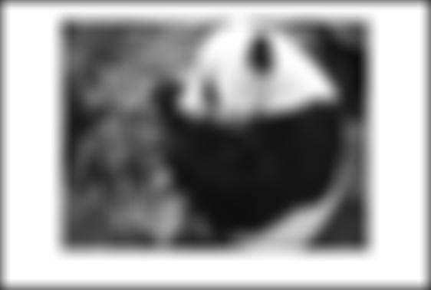
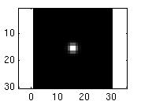
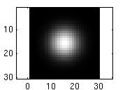

Smoothing with a Gaussian
Parameter σ is the “scale” / “width” / “spread” of the Gaussian kernel, and controls the amount of smoothing.
…

Slide 46

Predict the filtered outputs
0
0
0
0
0
0
*
= ?
*
= ?
0
1
0
0
0
1
0
0
0
0
0
0
0
0
0
-
1
1
1
*
= ?
0
2
0
1
1
1
0
0
0
1
1
1

Slide 47
Practice with linear filters
0
0
0
?
0
1
0
0
0
0
Original
Source: D. Lowe

Slide 48
Practice with linear filters
0
0
0
0
1
0
0
0
0
Original
Filtered
(no change)
Source: D. Lowe

Slide 49
Practice with linear filters
0
0
0
?
0
0
1
0
0
0
Original
Source: D. Lowe

Slide 50
Practice with linear filters
0
0
0
0
0
1
0
0
0
Original
Shifted left
by 1 pixel with correlation
Source: D. Lowe
Notes:
This is if we assume filter already flipped – will shift right if we flip the fitler first for convolution

Slide 51
Practice with linear filters
1
1
1
?
1
1
1
1
1
1
Original
Source: D. Lowe

Slide 52

Practice with linear filters
1
1
1
1
1
1
1
1
1
Original
Blur (with a
box filter)
Source: D. Lowe

Slide 53
Practice with linear filters
0
0
0
-
1
1
1
?
0
2
0
1
1
1
0
0
0
1
1
1
Original
Source: D. Lowe

Slide 54


Practice with linear filters
0
0
0
-
1
1
1
0
2
0
1
1
1
0
0
0
1
1
1
Original
Sharpening filter
Accentuates differences with local average
Source: D. Lowe

Slide 55
Filtering examples: sharpening

Slide 56
Shift invariant linear system
Shift invariant:
Operator behaves the same everywhere, i.e. the value of the output depends on the pattern in the image neighborhood, not the position of the neighborhood.
Linear:
Superposition: h * (f1 + f2) = (h * f1) + (h * f2)
Scaling: h * (k f) = k (h * f)

Slide 57

Properties of convolution
Linear & shift invariant
Commutative:
f * g = g * f
Associative
(f * g) * h = f * (g * h)
Identity:
unit impulse e = […, 0, 0, 1, 0, 0, …]. f * e = f
Differentiation:

Slide 58
Separability
In some cases, filter is separable, and we can factor into two steps:
Convolve all rows
Convolve all columns

Slide 59

Separability
In some cases, filter is separable, and we can factor into two steps: e.g.,
h
g
f
f * (g * h) = (f * g) * h

Slide 60
Separability
What is the computational complexity advantage for a separable filterin terms of number of operations per output pixel?
Filtering an M-by-N image with a P-by-Q filter kernel requires roughly MNPQ multiplies and adds (assuming we aren't using an implementation based on the FFT).
If the kernel is separable, you can filter in two steps.
The first step requires about MNP multiplies and adds.
The second requires about MNQ multiplies and adds
for a total of MN(P + Q).
The computational advantage of separable convolution versus nonseparable convolution is therefore: PQ/(P+Q)
For a 9-by-9 filter kernel, that's a theoretical speed-up of 4.5.

Slide 61
Effect of smoothing filters
Additive Gaussian noise
Salt and pepper noise

Slide 62
Median filters
A Median Filter operates over a window by selecting the median intensity in the window.
What advantage does a median filter have over a mean filter?
Is a median filter a kind of convolution?
Slide by Steve Seitz
Notes:
Better at salt’n’pepper noise
Not convolution: try a region with 1’s and a 2, and then 1’s and a 3

Slide 63

Median filter
No new pixel values introduced
Removes spikes: good for impulse, salt & pepper noise

Slide 64

Median filter
Salt and pepper noise
Median filtered
Plots of a row of the image
Source: M. Hebert

Slide 65

Median filter example
Very effective for removing “salt and pepper” noise (i.e., random occurrences of black and white pixels).
median
filtering
averaging

Slide 66
Comparison: salt and pepper noise
Slide by Steve Seitz

Slide 67

Median filter
Median filter is edge preserving

Slide 68




Order statistics filters
Other order statistics:
Min filter, max filter, x-percentile …
original

Slide 69
Sharpening Spatial Filters
The principal objective
highlight fine detail in an image or to enhance detail that has been blurred
either in error or as an natural effect of a particular method of image acquisition.
Normally, sharpening is done by highlighting the transitions in intensity
Methods
Unsharp masking
High Boost filtering
Laplacian (2nd order derivative)
Gradient (1st order derivative)

Slide 70

Unsharp masking and High boost Filtering
Blur the original image f(x,y)
Subtract the blurred image from the original (result called the mask):
Add the mask to the original:
k ≥ 0
• k = 1 => unsharp masking • k > 1 => highboost filtering

Slide 71





Example
Original
Blurred
Mask (scaled)
Unsharp Mask
High boost

Slide 72
The Laplacian (2nd order derivative)
Shown by Rosenfeld and Kak[1982] that the simplest isotropic derivative operator is the Laplacian is defined as
Discrete form of derivative
f(x-1,y)
f(x,y)
f(x+1,y)
f(x,y-1)
f(x,y)
f(x,y+1)

Slide 73


The Laplacian - mask
The digital implementation of the 2-D Laplacian is obtained by summing 2 components
Edges can be found
by detect the zero-crossings

Slide 74
The Laplacian - mask
Isotropic mask with 45° rotation increment
Isotropic mask with 90° rotation increment
0
1
0
1
1
1
1
-4
1
1
-8
1
0
1
0
1
1
1
1
0
1
0
-4
0
1
0
1

Slide 75
Laplacian mask
variants
0
-1
0
-1
-1
-1
-1
4
-1
-1
8
-1
0
-1
0
-1
-1
-1
-1
0
-1
0
4
0
-1
0
-1

Slide 76
Sharpening using Laplacian
If the center coefficient is negative
If the center coefficient is positive
Where f(x,y) is the original image
is Laplacian filtered image
g(x,y) is the sharpen image

Slide 77



Laplacian - Example
Laplacian without scaling
Original
0
-1
0
-1
4
-1
0
-1
0
with scaling

Slide 78


Sharpening: Laplacian - example
Original
Sharpened with Laplacian

Slide 79
Sharpening: Laplacian
Using Laplacian filter to original image
And then add the Laplacian result to the original image
Simplification
We can apply two step in one mask
0
-1
0
-1
-1
-1
-1
5
-1
-1
9
-1
0
-1
0
-1
-1
-1

Slide 80
The Gradient (1st order derivative)
First Derivatives in image processing are implemented using the magnitude of the gradient.
The gradient of function f(x,y) is
The magnitude of this vector
Gradient is a linear but not rotation invariant (isotropic)
Magnitude is not linear, but is isotropic
Approximation
Isotropic property lost (in general)

Slide 81
The Gradient
The simplest approximations to a first-order derivative are
Robert’s cross operator
G_{y}
-1
1
This mask is simple, and no isotropic. Its result only horizontal and vertical.
1
G_{x}
-1
-1
0
y
0
1
z₁
z₂
z₃
G_{x}
x
z₄
z₅
z₆
G_{x} = (z₉-z₅) and G_{y} = (z₈-z₆)
0
-1
z₇
z₈
z₉
1
0
G_{y}

Slide 82
Sobel’s Method
Mask of even size are awkward to apply.
The smallest filter mask should be 3x3.
-1
-2
-1
-1
0
1
0
0
0
-2
0
2
1
2
1
-1
0
1

Slide 83




Example: Gradient Magnitude Image
Gradient Magnitude
(isotropic)

Slide 84



Example: Laplacian vs Gradient
Sobel
Laplacian

Slide 85


Take-home messages
Linear filtering is sum of dot product at each position
Can smooth, sharpen, translate (among many other uses)
Be aware of details for filter size, extrapolation, cropping
1
1
1
1
1
1
1
1
1

